Slide 1
Analyzing Transition Data Using the Transition Pairing Method
Paul R. Hibbing
2020-05-05
Notes:
Hi everyone, I want to talk about an approach I’ve developed for assessing how segmentation algorithms perform. I think it’s a good first step on thorny analytical issue that we haven’t given a lot of attention to in the past. So hopefully we’ll be able to raise awareness a bit, and then maybe some of you will have ideas to refine the method going forward.

Slide 2
Presentation Outline
Status Quo
Formulation
Implementation
Notes:
I’ve decided to approach this more like a commentary rather than a study. I do have a paper in press on the topic, but for time and maybe the interests of this group I think we can deviate a little bit and maybe skip to the good stuff. So I’m going to start by looking at the status quo for how we analyze this type of data, and then I’ll get into my method, and specifically the way that I formulate the problem, and how my method is implemented.

Slide 3
Status Quo
Notes:
So to get started I want to visualize how our data processing and analysis pipeline often looks.

Slide 4
Notes:
We start with some criterion observations that we can represent in blocks like this

Slide 5
Notes:
And then we have some sensor data collected throughout that time frame.

Slide 6
Notes:
We then apply our segmentation algorithm to the data, and we get partitions shown with the dashed lines here.

Slide 7
Notes:
And then we make a prediction for each segment, perhaps using a neural network. That’s kind of the data processing piece. And then for analysis…

Slide 8
Notes:
… we line everything up using a subdivision process which is shown here with all these lines.

Slide 9
Notes:
That gives us measured and predicted values that we can compare in one-to-one fashion.

Slide 10
Metrics
Diagnostics
Needleman-Wunsch
Rand index
Matthews correlation
Notes:
So here are some metrics that get used here.
There are limitations with each of these metrics, and the one global limitation is that all of the analytical information is coming from the interior of these boxes, whereas when we’re talking about segmentation, we’re really only interested in the edges. These metrics can tell us a little bit about the edges, but for the most part that information gets washed out by the comparisons for each slice of data, since the non-transition data points far outnumber the transitions.

Slide 11
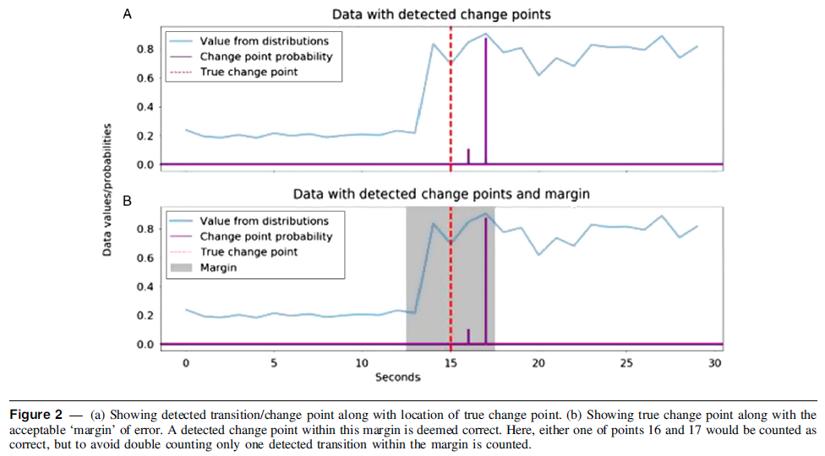
Other approaches
Segment duration
Assumes correct number of segments?
Does not account for segment offset
RMSE
And more…
Aminikhanghahi & Cooke (2017)
ncbi.nlm.nih.gov/pmc/articles/PMC5464762/
Twaites et al. (2019)
Notes:
There are also some other approaches that are maybe a little closer to the target.
This Twaites paper in JMPB is actually a pretty good reference in terms of trying to address some of the oddities or complexities of this type of data. I still think it falls short, along with the other methods which are covered really nicely in this paper by Aminikhangagi & Cooke.

Slide 12
Formulation
Notes:
So I’m going to transition into some discussion about my TPM, and the first part of that is to go through how I think about the problem.

Slide 13
Notes:
Instead of the boxes I showed before, I think of things in terms of these dots. Here we have an algorithm that predicts transitions at certain time points, and those predictions are open dots labeled ABC etc.

Slide 14
Notes:
There are also criterion transitions that occur at their own times. Those are closed dots here, labeled with 123 etc.
Our fundamental interest is to know two things about our algorithm: First, does it predict the correct number of transitions, and second, does it predict the correct timing of the transitions? The first question is categorical in nature: If we get the number of transitions wrong, we’re talking about false positives/negatives. The second question is numerical in nature, where lag time is a continuous variable.
The tricky thing is addressing both of those questions at the same time, getting the categorical and the continuous to play nicely. And even more specifically, the true core of the problem is determining which predictions and criteria should be compared.

Slide 15
Notes:
In these three cases, it’s pretty obvious what the comparisons should be, and those are shown with the connector lines. But that’s unrealistic. What’s truly realistic is this scenario over here…

Slide 16
Notes:
In this case, we’re forced to ask whether this is a valid pairing with a large lag time, or whether the lag time is so great that the pairing should be considered spurious, and point D and point 4 should be labeled false positive and false negative, respectively.
The other thing is, prediction D is closer to criterion 3 than criterion 4. In this case it doesn’t matter much, but…

Slide 17
Notes:
… in this case that property adds a lot of complexity. These dotted lines are showing that each prediction is “reasonably close” to multiple criteria. In a way, this creates a lack of independence, because the assignment we make for one prediction/criterion pair affects the options for other predictions nearby. And the biggest consequence is that we could get different pictures of how far off our predictions are, depending on which assignments we make.

Slide 18
Notes:
The same issues exist if we have too many predictions, rather than too few. In all these scenarios we’re looking for a rule or system that can make pairings for us. Something like…

Slide 19
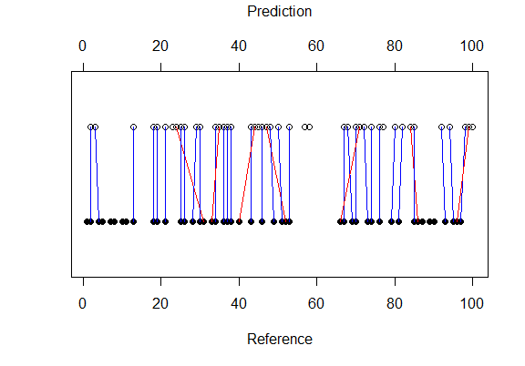
Notes:
… this. Once we’ve determined what the pairs should be, it’s easy to define true positives, false positives, and false negatives. And for the true positives, we can also examine lag time.
So, now we’re in position to discuss the TPM. The whole novelty of it is to assign the pairs using an extended Gale-Shapley algorithm, and then make sure the pairings make sense sequentially by rejecting any that occur out of order, which is what the red lines show here.

Slide 20
Implementation
Notes:
So let’s shift gears and look more deeply at how the TPM actually gets invoked.

Slide 21
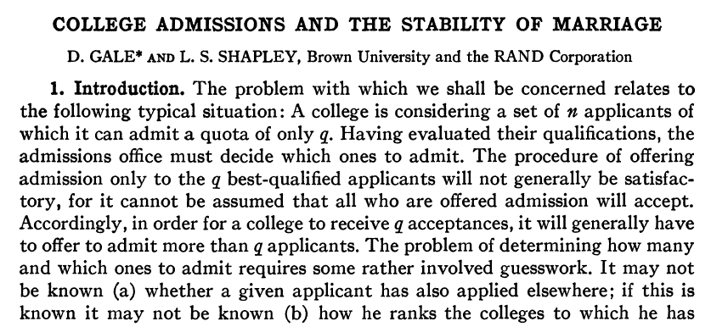
Notes:
The first thing to touch on is the Gale-Shapley algorithm itself. This is their paper, published in 1962, and the algorithm has been adapted a bunch of ways since then, for a lot of uses including the process of assigning medical graduates to residency programs.

Slide 22
Notes:
The gist is, each prediction and each criterion “ranks” all the others from most to least preferable, where we’re using time lag as a measure of preference. So the less lag time, the higher the preference.
We pre-specify a lag time threshold called the spurious pairing threshold, where we say, any preferences beyond x time units are illegal. Then we run the algorithm to tell us which pairs should be formed.

Slide 23
Notes:
Lastly, we check that predictions are sequential. We expect that our algorithm is detecting transitions as they happen, plus or minus some margin. That’s well and good, but if there’s already another pair in that margin, it seems like we’re making a spurious connection that we should disqualify. Again, that’s what the red lines are showing here.
The algorithm has some nuanced properties that we can’t get into, but this is the gist. Now let’s talk about metrics. To set that up, I want to go back to the spurious pairing threshold. Our results can change depending on how much lag time we allow. But a good algorithm will be about as effective when we allow short lag time as long lag time. So one thing we want to look at is how much the performance changes when we vary how much lag time we allow. That’s what we’ll look at in the figures.
Remember, we have both a categorical and a continuous aspect of our question.

Slide 24
Notes:
On the categorical side, we’re focused on recall and precision, which have a bunch of other names including sensitivity and positive predictive value.
In these panels we’re looking at the youth Sojourn segmentation algorithms for raw acceleration data on the hip or wrist. Error bars are metric variability across participants. So on the left, we can see that we have to allow around 6-s of lag time before recall exceeds 50%, meaning we’re detecting 50% of transitions. On the right, we can see that precision is basically low no matter what, meaning that very few of the predicted transitions are actually true positives.

Slide 25
Notes:
On the continuous side, we can look at RMSE of the lag times. RMSE is always bounded below by 0, but what’s interesting here is that it’s also bounded above by the line of identity. So if you like, you can express RMSE on a percentage scale, where 0% would be the line of identity and 100% would be RMSE of 0. Since recall and precision have that same percentage scale, you can also define a single, aggregate measure of performance which is the mean of all three.

Slide 26
Appendix

Slide 27
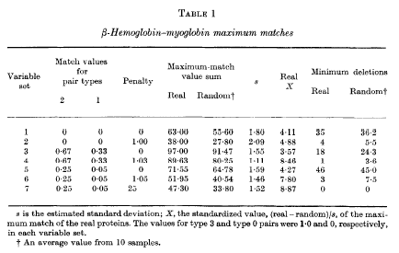
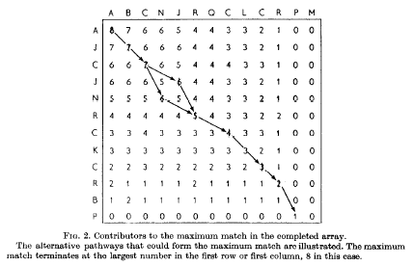
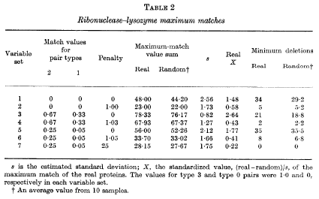
Needleman-Wunsch (Shahi et al., 2017)
Needleman and Wunsch (1969)
Needleman and Wunsch (1969)
Notes:
important topic is CAM-TPM comparison… to bring out more fully what the exact limitations of the CAM are, and
how TPM improves.
… a few studies to get at, starting Nyan.
They were working on some gait pattern classification using wearable sensors, and specifically looking at segment duration.
They used some similar metrics to this study...
However, limitations...
One … assumes the correct number of segments, which may be reasonable for gait analysis...
It also focuses on duration… not onset/offset.
That places a lot of emphasis on … within a segment, which way more information...
So the pure bout-detection information gets washed out...
We saw that in the demonstration...
Another study (Shahi)...
They used protein sequencing comparison algorithm...
The same limitation applies… volume of within-bout information completely overwhelms the information that could be gained about bout-detection.
… also difficult to interpret.
…illustration and results for two proteins. As you can see, you have a pretty specialized interpretation...
challenging and unintuitive to use the Needleman-Wunsch algorithm to interpret/compare findings for different algorithms across studies.

Slide 28
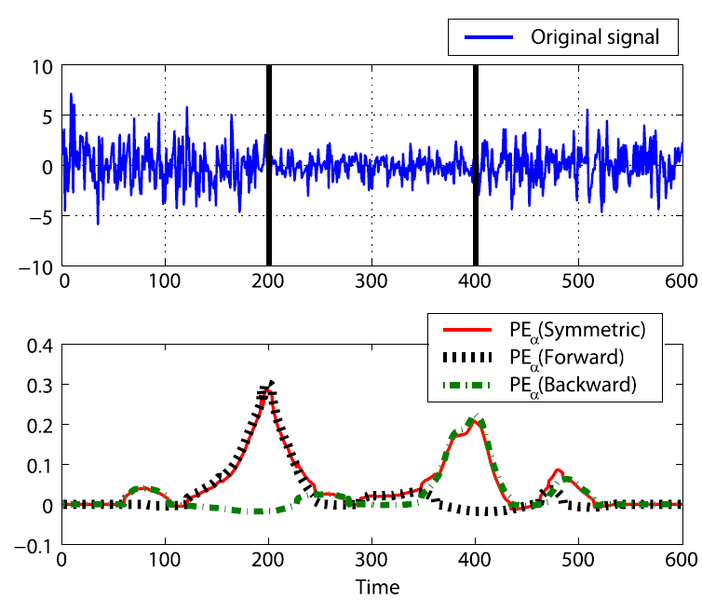
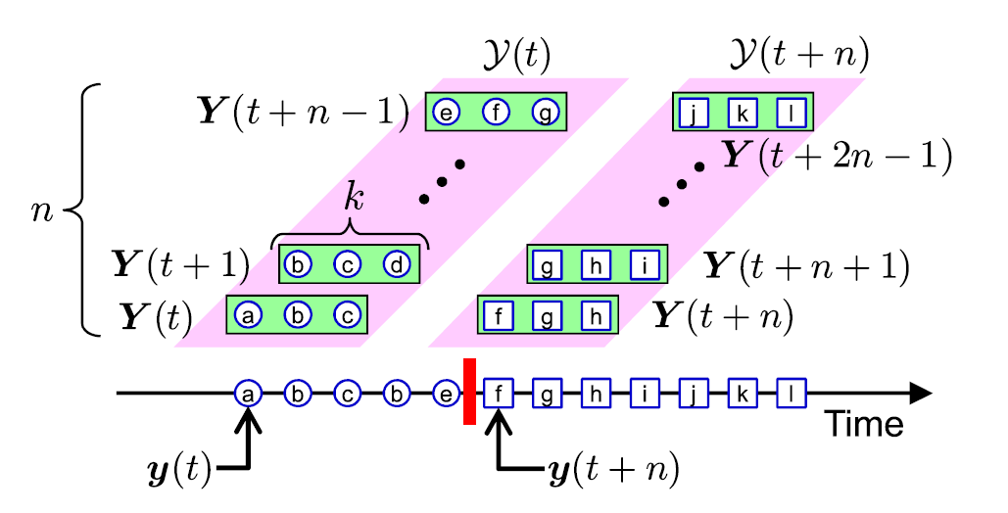
Change Point Detection
Liu et al. (2013)
Liu et al. (2013)

Slide 29
Activities
Supine Rest
Reclining
Computer Games
Internet Surfing
Book Reading
Sweeping
Dusting
Stationary Cycling
Catch
Jumping Jacks
Soccer
Basketball
Slow Self-Paced Walking
Brisk Self-Paced Walking
Self-Paced Running
Repeated Ascent/Descent of a Flight of Stairs
TPM Demonstration: Methods
Notes:
Here are the 16 activities, ranging from sedentary to vigorous.

Slide 30
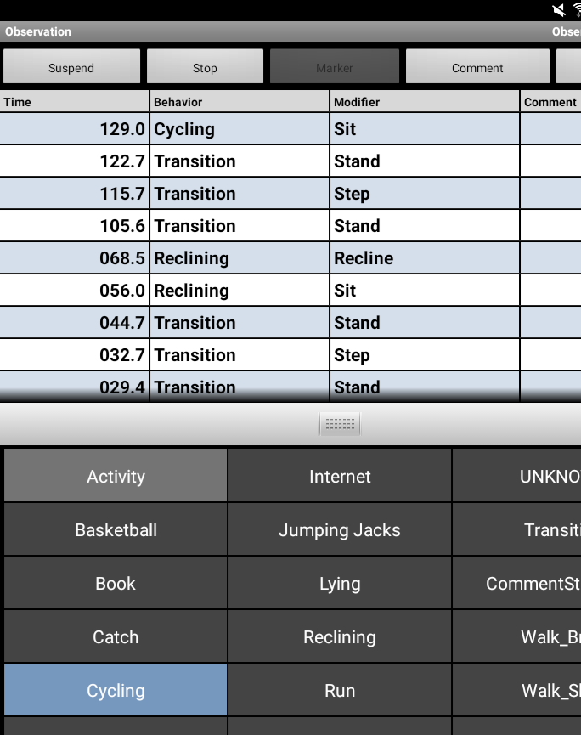
Equipment/Data
ActiGraph GT9X
Right hip & non-dominant wrist
Primary accelerometer
90-Hz sampling rate
Reduced to 1-s epochs
Youth Sojourn bout detection algorithms
Noldus Observer XT
Coding scheme for behavior & posture
Pocket Observer
TPM Demonstration: Methods
Notes:
Specifically, we’re going to look at data from two ActiGraph GT9X devices worn on the hip and non-dominant wrist, respectively. We used the youth Sojourn algorithms to predict transitions after reducing the raw acceleration data to 1-s epochs.
Direct observation was our criterion measure. We used Noldus Pocket observer on an Android tablet, which you can see here in the screenshot. That allowed us to click buttons whenever behavior changed, and then we used that to label the 1-s epochs with the corresponding behavior. Anytime behavior changed, we called that a transition, so the data looked…

Slide 31
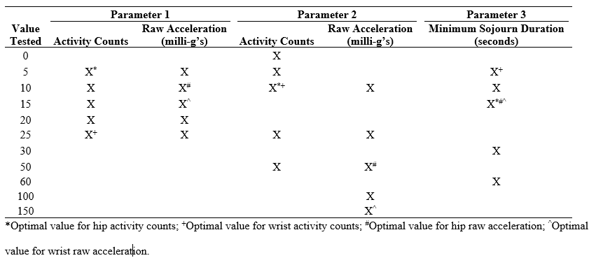
Youth Sojourn Models
Bout Detection Algorithm
Parameter 1: Required difference between neighboring epochs
Parameter 2: Max value for second epoch when comparing neighboring pairs
Parameter 3: Minimum bout duration
Artificial Neural Network
Decision Tree
Appendix
Notes:
The youth Sojourn models have a multi-component setup that’s used to estimate activity intensity (sedentary, light, or MVPA).
The first part is a bout-detection algorithm
…three parameters of the bout-detection algorithms, which differ depending on...
……first is how different the counts or acceleration need to be from one second to the next in order for a new bout to be triggered.
……second is how low the second value has to be in neighboring epochs for a new bout to be triggered.
……third is the minimum duration of a bout.
Once segmented, an ANN is used to generate predicted intensity in two ways,
…static 15-s windows
…dynamic segments defined by the algorithm.
Finally, decision tree integrates the preceding information with the actual counts or acceleration values, to generate a final estimate.
Now reviewed Sojourns, back to analyses.

Slide 32
Conventional Analysis: Intensity Classification
Criterion labels
Sedentary: ≤ 1.50 MET_{yBMR} and seated/lying posture
Light: 1.51-2.99 MET_{yBMR}
MVPA: ≥ 3.00 MET_{yBMR}
(standing posture with ≤ 1.50 MET_{yBMR} coded as light)
Data excluded if any source missing or MET_{yBMR} ≤ 0.2
Classification metrics for each participant (minimum one day of data)
Data from both days concatenated, if applicable
Overall agreement (percent correct classification; kappa)
Mean kappa categorized with Altman cutoffs, i.e., poor (≤ 0.20), fair (0.21-0.40), moderate (0.41-0.60), good (0.61-0.80), or very good (≥ 0.81)
Intensity categories (sensitivity & specificity)
Paired T-tests (α = 0.05) comparing hip-vs-wrist means for each metric
TPM Demonstration: Methods
Notes:
focused on conventional analytic method to compare the classification accuracy...
If we go back to snapshot I gave, we’re looking at these rightmost columns now.
Here’s how determined labels.
The cutoffs include posture due to…
weren’t supposed to sleep here, so we’re ignoring that.
We excluded data...
Once classified, we calculated these metrics for each individual… paired T-tests to
compare the hip-versus-wrist means.

Slide 33
TPM Demonstration: Methods/Results
Notes:
I know we’re moving quickly, but hopefully this demonstration will help to fill in some of the gaps.

Slide 34
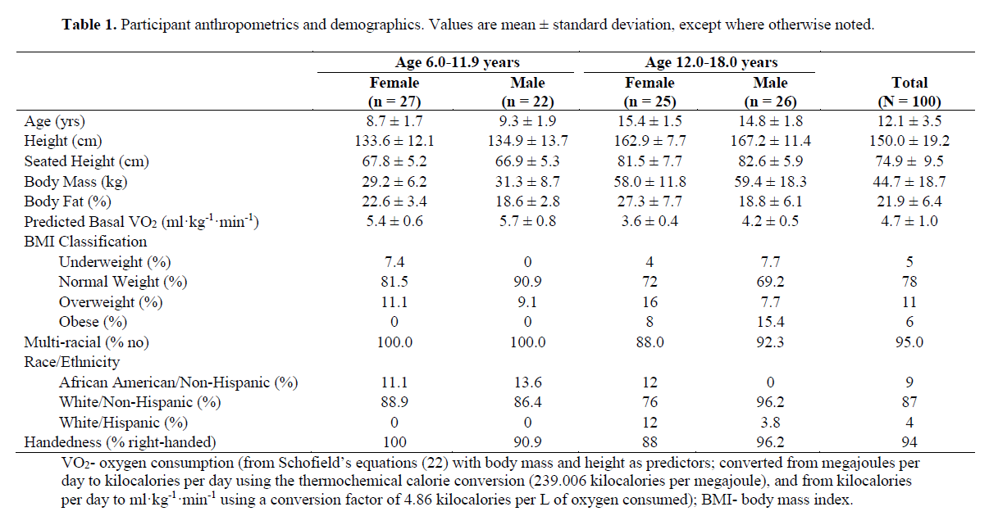
Participants
TPM Demonstration: Methods
Notes:
We’re going to look at data from a study that included 100 participants ages 6-18. They were mostly normal weight, non-Hispanic, and white, with a fairly even distribution of males and females and those younger vs older than 12 years old.

Slide 35

Protocol
ActiGraph GT9X
* Hip & Non-Dominant Wrist
* Youth Sojourn Algorithm
Two visits
Initial processes
Demographics/Anthropometrics
Resting Metabolic Rate
Sixteen activities
Eight per visit
Performed twice each
60-s to 90-s
4-min to 5-min
Accelerometry, direct observation
TPM Demonstration: Methods
Notes:
Participants came to the lab on two occasions. From a list of 16 activities, 8 were performed each day, twice each in a way that simulated realistic transition patterns between activities. Throughout each visit, participants were fitted with the equipment seen here. Direct observation was performed in real time to generate a timestamped log of activity behaviors.

Slide 36
Data Processing
TPM Demonstration: Methods
Notes:
… like this. You can see we have timestamps indicating 1-s epochs, and then we have three columns indicating whether or not that second was a transition: One column each for the two Sojourn bout detection algorithms, and then a third column for the criterion measure.

Slide 37
Analysis
TPM used to compare hip algorithm to non-dominant wrist algorithm
Metrics obtained from each participant (minimum one day of data)
Data from both days combined, if applicable
Paired T-tests (α = 0.05) comparing hip-vs-wrist means for each metric
Repeated for different spurious pairing threshold values
1-s to 20-s in 1-s increments
TPM Demonstration: Methods
Notes:
For the analysis, we used the TPM to calculate TPR, FNR, PPV, and mean lag time for each participant. Then we compared the hip-vs-wrist means using paired t-tests. We repeated this process with different allowances for how far apart we allowed the true positive pairs to be. That is, we repeated the analysis with different values of the spurious pairing threshold, from 1-20 seconds, in 1-s increments.

Slide 38
TPM Demonstration: Results
Notes:
We talked about doing the analyses at different settings of the spurious pairing threshold, and that’s what’s shown here. Obviously, the outcomes were dependent on what that setting was, and that doesn’t reflect well on a bout detection algorithm.
First we’ll focus on true positive rate. To get above 50% we had to allow pairings up to 6-s different (hip) and 5-s different (wrist). To get above 75% we had to allow up to 14-s (hip) and 10-s (wrist).

Slide 39
TPM Demonstration: Results
Notes:
If we look at false negative rate, it’s the inverse of true positive rate, by definition. So the trends are opposite here to those I just described.

Slide 40
TPM Demonstration: Results
Notes:
Lastly, if we focus on positive predictive value, we never got above 50% for either algorithm, regardless of the spurious pairing threshold. That means that less than half of predicted transitions are true positives, and realistically much less than half.

Slide 41
TPM Demonstration: Results
Notes:
For mean lag times, the hip and wrist were virtually identical, with significant differences of 0.1-0.2 sec for only SPT settings of 4-7 sec.
The best possible performance would be a flat line at 0, and the worst possible performance would follow the line of identity, based on the properties of the TPM. Both algorithms were closer to the worst-possible value than the best-possible value when the SPT was 1-s, and gradually became closer to the best-possible value, at a SPT of 5-s for the hip and 4-s for the wrist.

Slide 42
Results: Conventional Analysis
TPM Demonstration: Results
Notes:
(classification accuracy using the conventional analytic method).
So we’re no longer looking specifically at bout-detection, now we’re looking at classification of sedentary, light, and MVPA, as well as overall agreement.
You can see that sensitivity for sedentary… higher wrist,
whereas similar for light and MVPA.
Overall percent correct classification was 6.1% higher wrist…
and the kappa was moderate wrist and fair hip.

